Slide 1

Blissymbolics Communication International
Providing support to the application of Blissymbolics since 1975

Slide 2

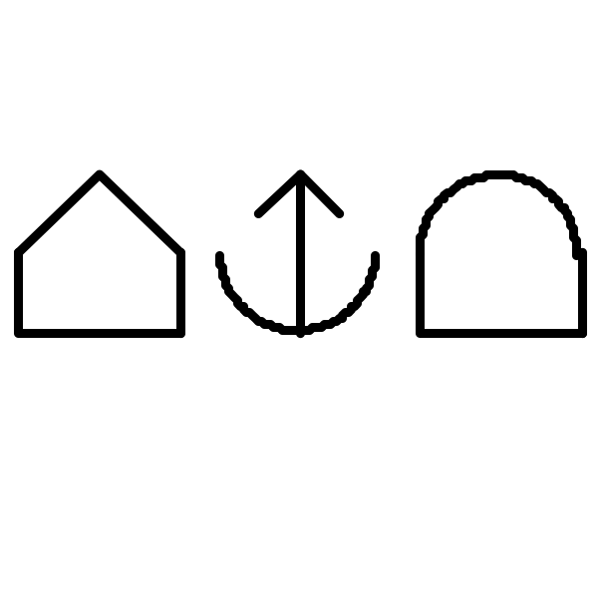
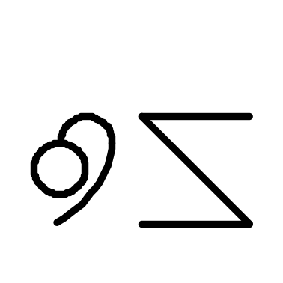
Blissymbolics
at
Ottawa Children’s Treatment Centre
School

Slide 3
Why Bliss?
Why not words or pictures?

Slide 4














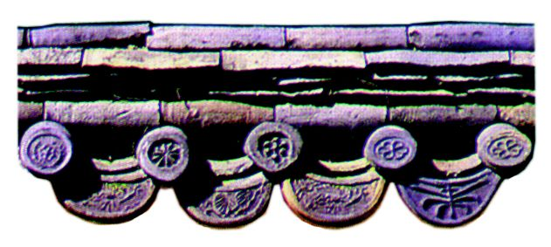



g
m
t
a
n
u
b
h
w
i
o
c
k
d
r
e
l
s
Notes:
18 shapes Minsymbol-like rich in content for associations

Slide 7

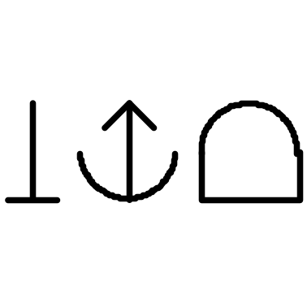

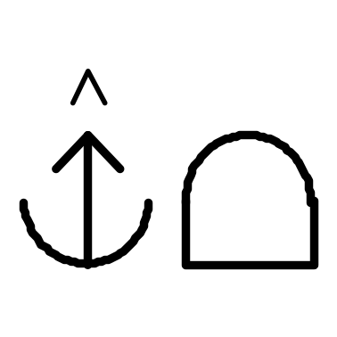
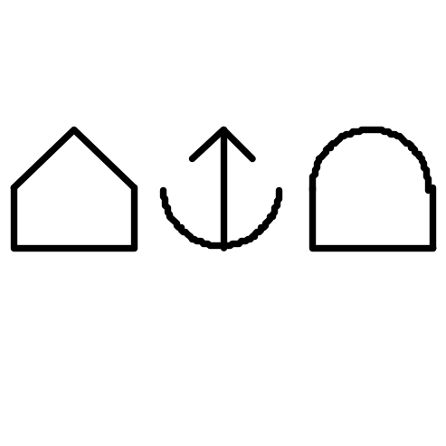
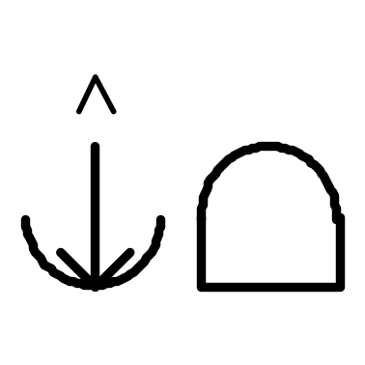
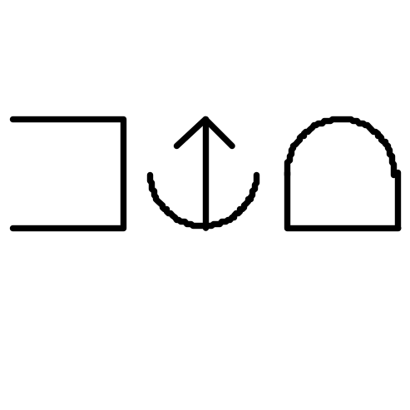


Slide 8
teacher
student
school
classroom
knowledge

Slide 9
teach
learn
building

Slide 10
teacher
knowledge
student
teach
school
learn
classroom
building

Slide 11
The ABC’s of Bliss!

Slide 12
A
Augmentative and Alternative Communication
Bliss was there at the beginning (1971)
as a pioneer in the field of AAC.
Bliss helped with the establishment
of an international organization in 1983 –
International Society
for Augmentative and Alternative Communication
ISAAC

Slide 13
B
Blissymbolics and Its Language Bonuses
Begin with Communication
And you get additional support for:
Language development
Cognitive development
Literacy acquisition

Slide 14



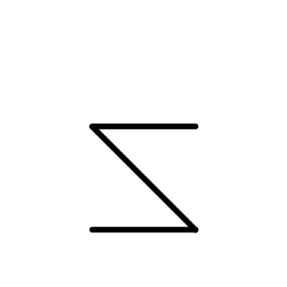



language
mouth
ear
Blissymbol
sky
earth
world
writing tool

Slide 15

C
First, Bliss is used for Communication.
As a language, Blissymbolics needs
to be used within a community of users
When Blissymbolics
is the language used for communication,
WE need to be creative.
We do this through the ‘Combine’
and other Strategies. Be watching for them.

Slide 16
D
Delightful
Duality
Because ‘Bliss’ is a language
Blissymbolics
has
Characters
Words
AND

Slide 17
E
When there are Bliss users
in a school
Everybody can learn from it!

Slide 18


Here’s how ---
Think of delightful duality.
Here are the Bliss-characters
in the Bliss-word for school
building
giving
knowledge
They spell
school

Slide 19


F
And when everyone uses Bliss ….
It’s FUN!

Slide 20


F
Within fun, you see
feeling
up
(= happiness)
Whenever you see
a heart, think “feeling”!

Slide 21

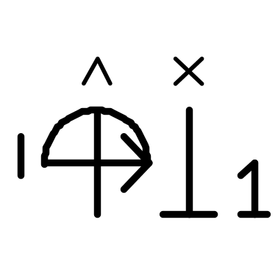


G
Let’s go for it!

Slide 22
Part Two
Using the alphabet
To learn and ‘expand’ Bliss vocabulary

Slide 23


H
house
house + feeling = home
house + animal = barn

Slide 24

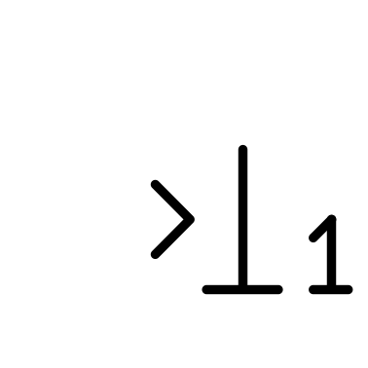
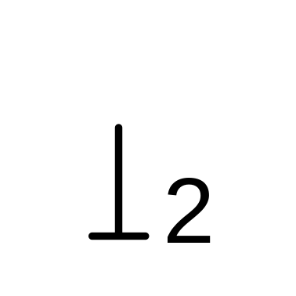
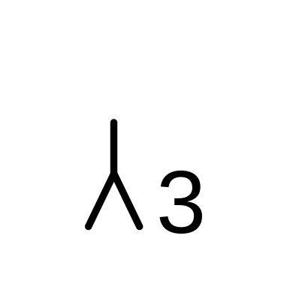

I
Let’s learn some pronouns!
I
me
you
he
she

Slide 25

Here’s a verse to help you remember pronouns.
I am 1
and you are 2
and he and she are 3.
And to help you remember “me” ….
to
“to” coming to “I” changes “I” to “me”

Slide 26
Here are the pronouns again!
I
me
you
he
she

Slide 27





J
juice
The Bliss-characters in juice are:
derived from
and
drink
food
liquid
and
fruit

Slide 28




K
Derived from
+
knowledge
mind
house
“store house of the mind”
From knowledge we get
to know
and to understand
Note the verb indicator

Slide 29

L
Love
Could anything be easier?

Slide 30












M
Mother and other family members
mother
father
sister
brother
grandmother
grandfather
They are all derived from the Bliss-characters …
protection
woman
man
parent
creation
action

Slide 31




N
For all the negatives!
No!
without
To subtract,
take away,
remove
not

Slide 32
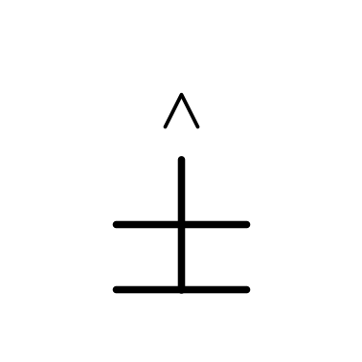
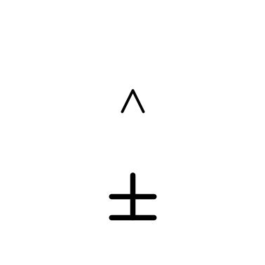

O
Ownership
Provides rationale
for possessive
and belongs to
To own
To have
Note
sky line
Big meaning
Little meaning
earth line

Slide 33


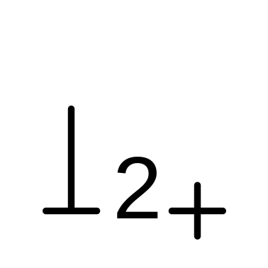



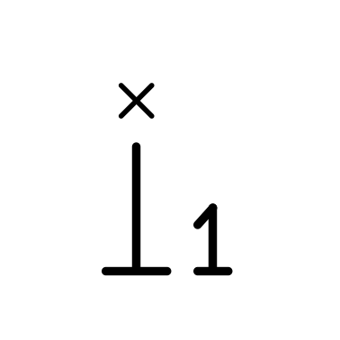
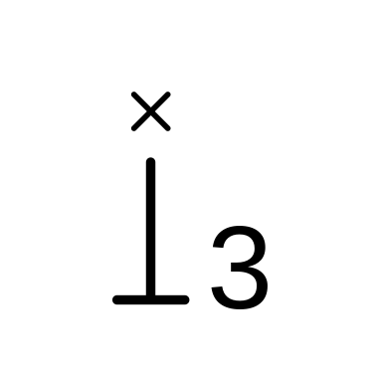



P
Possessive
Person
Pronouns
Plural
Pointer

Slide 34
P
Possessive
possessive
and ‘belongs to’
mother’s
father’s

Slide 35

P
Person
doctor
doctor’s
teacher
person who gives knowledge
(Possessive)
person of medicine

Slide 36
P
Pronouns
I
you
my, mine
your
yours

Slide 37
P
Plural
multiplication
we
they
plural indicator

Slide 38
P
Pointer
about
leg
foot
hip

Slide 39






Q
Questions
question
questions
what?
why?
what cause?
when?
what time?
where?
answer
answers
what place?

Slide 40
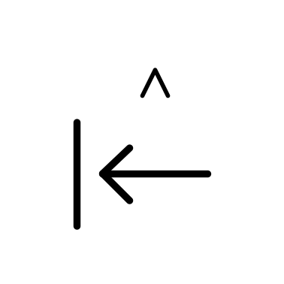

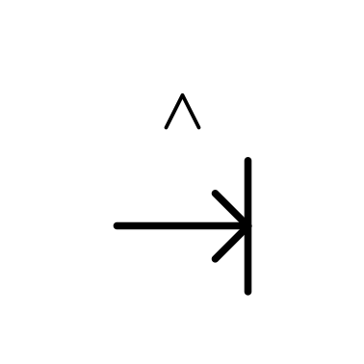
R
I really wanted to teach you ‘return’
and show other examples of the arrow being used!
return
leave
start
arrive
But …………

Slide 41


Take a little rest!
You deserve it!
Rest: Feeling of being at ‘rest’ with the earth
Peace: feeling of being at one with the world

Slide 42

S
Strategies
The two most frequently used ones are:
Opposite meaning
Combine strategy to produce new Bliss-word

Slide 43


Examples of Opposite Meaning strategy
Opposite of happy = sad
Opposite of sad = happy

Slide 44
Example of Combine Strategy
Period of time in which you have happiness = fun
More this afternoon!

Slide 45


T
time
If you add a thing indicator
You get clock
Here’s “fun” again!
It’s second and third characters are feeling + up = happiness.
It’s first character is ‘period of time”

Slide 46






T
The other time symbols you need are:
past
present
future
Watch for them as tense indicators on verbs, e.g.
was
am
will be

Slide 47
Suggest some ways
you might teach the past, present, future
past
present
future

Slide 48




U
The best thing you can do
to help a Bliss user
is to USE the Bliss board with them.
To use
mind
thing
hand
tool
(thing + hand)
To use: mind + tool; to manipulate a tool rationally
Blissymbol Reference Guide

Slide 49

V
Verbs are very important.
They represent action.
Their indicator is the action shape
Think volcano for verbs – action!
Their Bliss-board colour is green.
The “V” shape is used in Bliss
for description and evaluation Bliss-words.
Their Bliss-board colour is blue.
We call them adjectives and adverbs

Slide 50
W
“W” reminds us that in Blissymbolics there are Bliss-words
made up from Bliss-characters
And that Bliss-words are sequenced
to form Bliss-sentences.
You’ll be amazed at how long these sentences will become
once your students realize
the power of their language!
Remember the “Delightful Duality” of Bliss!

Slide 51


X
Remember the big and little meanings of
To own
To have
Multiplication has big and little meanings too.
multiplication
much. many
group of

Slide 52

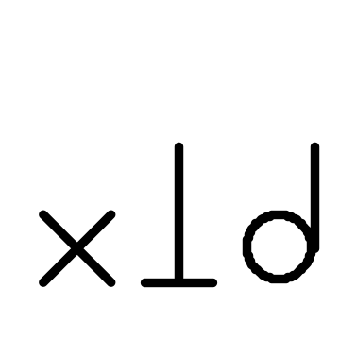

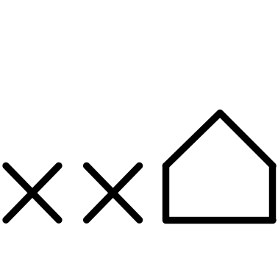
Here are some groups:
group (of people)
musical group
village
city

Slide 53
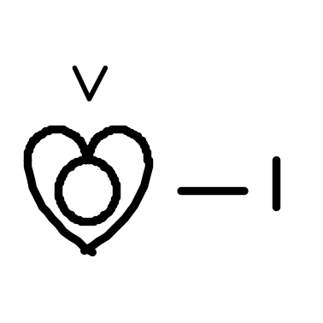
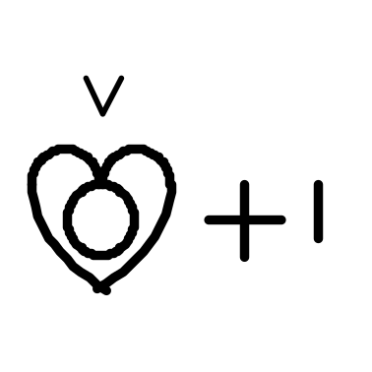
Y
“Y” is for
Yuck!
and
Wow!
Or whatever words YOU wish to give these symbols!

Slide 54

Z
Z is the shape
you do NOT use
for the symbol for Blissymbol!
Let the characters tell you why!
to destroy
writing tool
world

Slide 55
If you want to learn more about Blissymbolics -
Here is what you can do!
Go to www.blissymbolics.org/moodle
This website has been written
for those who want
to help teach Blissymbols ‘

Slide 56

Thank-you!

Slide 57
Rules for Combining
Aim for conciseness.
2. Use established Bliss-characters.
3. Position the combine indicator
before and after sequenced characters.
4. Position classifier (what kind of a thing)
Examples: person, building, feeling, etc.

Slide 58
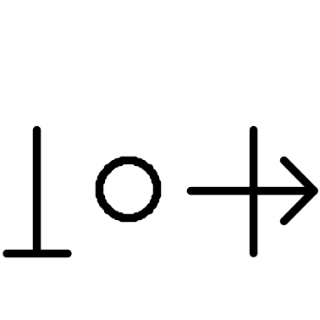

Slide 59

Notes:
  Links between hubs represent links between all hubs.
Chair of co-ordinating committee sits on executive.
All hub chairs will be board members.
4. Operational work of Hubs is reported to Board of Directors through the co-ordinating Committee to Executive Committee.
Members of the Corporation
Executive and
Operations
Committee
BCI Board
Communications
Language
Instructor
Training
Co-ordinating
Committee
(hub chairs)
Financial
Teaching
and
Learning
Materials
Technology
Bliss & AAC Communities & Individuals
General Public

Slide 60
Members of the Corporation
Executive and
Operations
Committee
BCI Board
Communications
Language
Instructor
Training
Co-ordinating
Committee
(hub chairs)
Financial
Teaching
and
Learning
Materials
Technology
Bliss & AAC Communities & Individuals
General Public

Slide 61
Structure for Access to Information
WEBSITE
PUBLIC ACCESS
BCI “Window Shopping” - To promote
Bliss Awareness, Education & Recruitment of Resources
Free Resources
e.g. Font, Vocabulary,
Bliss 101 Instructor Training, Selected Books
SUBSCRIPTION to Access Additional Resources
Policy re “Free
for subscribers”
& “Charge for
Commercial Users”
to be determined
VIEW BCI HUBS
Workrooms
Communication
VIEW Resources
e.g. Teaching materials, dictionary software
TIME AND TALENT - PARTICIPATION
PARTICIPATE in
BCI HUBS
Workrooms
Communication
CONTRIBUTE TO Resources
e.g. Teaching materials, Vocabulary development, software

